Slide 1
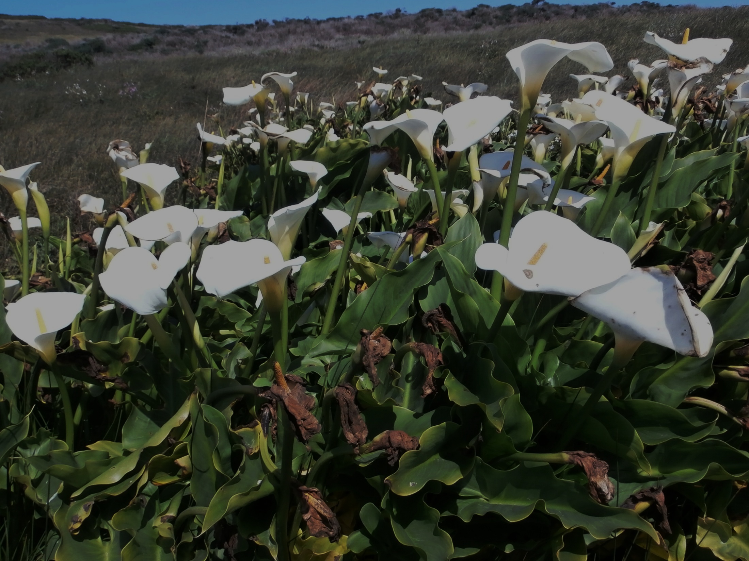
The effect of movement pattern differences in native and nonnative snails on population dynamics
Robin Decker
Terrestrial Field Ecology
May 25th, 2015

Slide 2
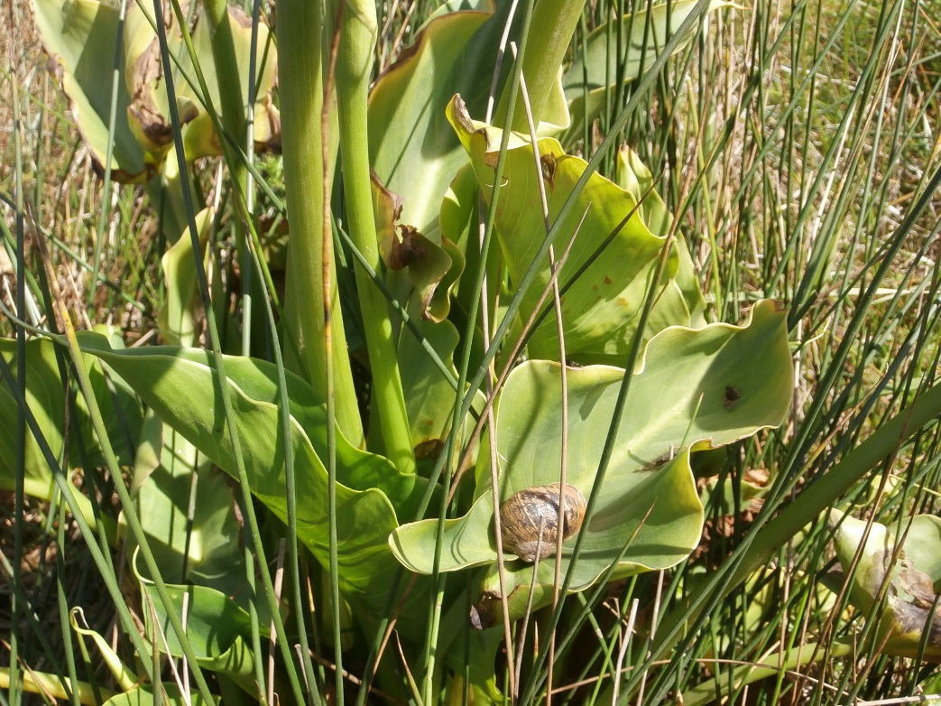
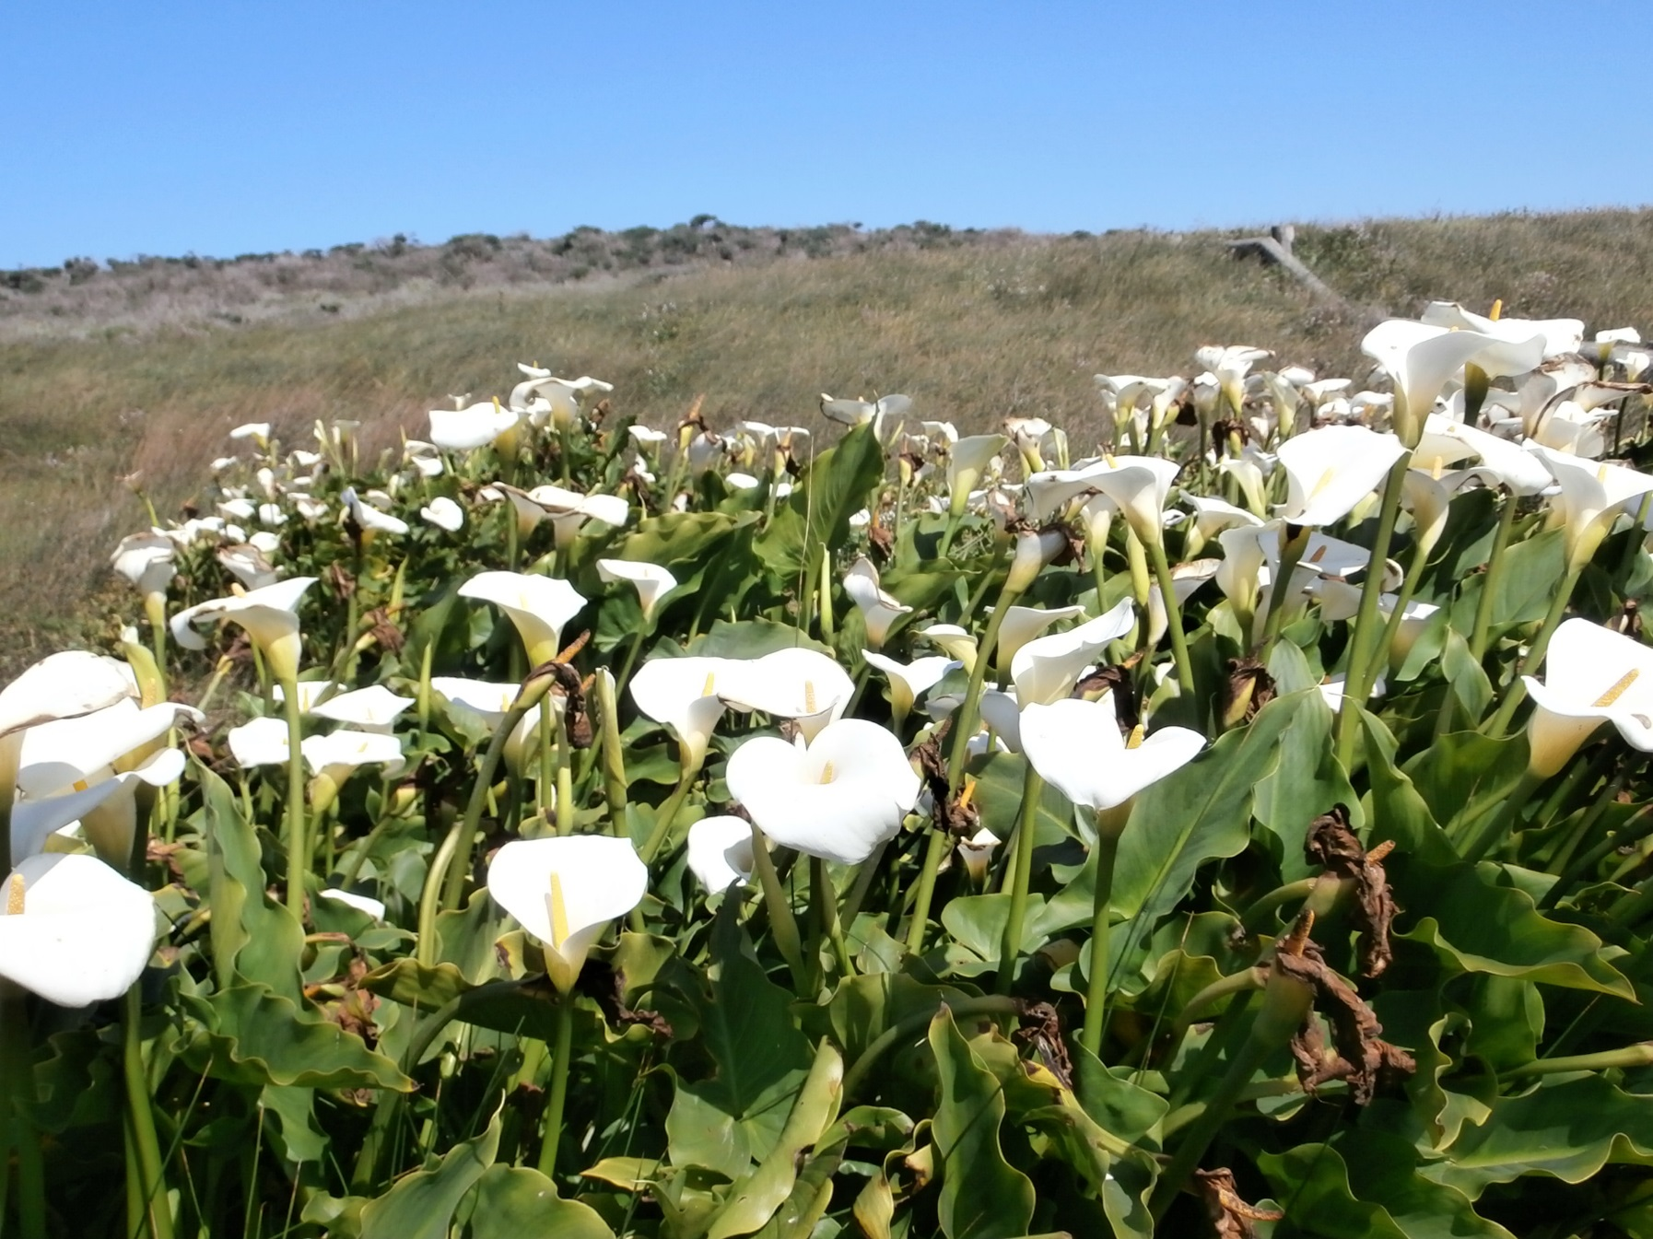
Outline
Introduction
Individual snail movement experiments
Snail group experiments
Simulation of snail population dynamics based on differences in movement patterns between species

Slide 3
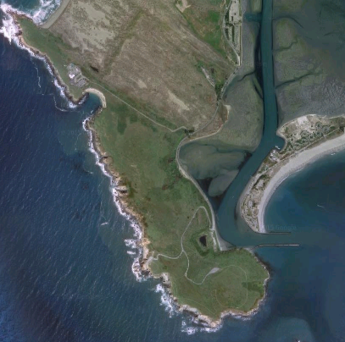
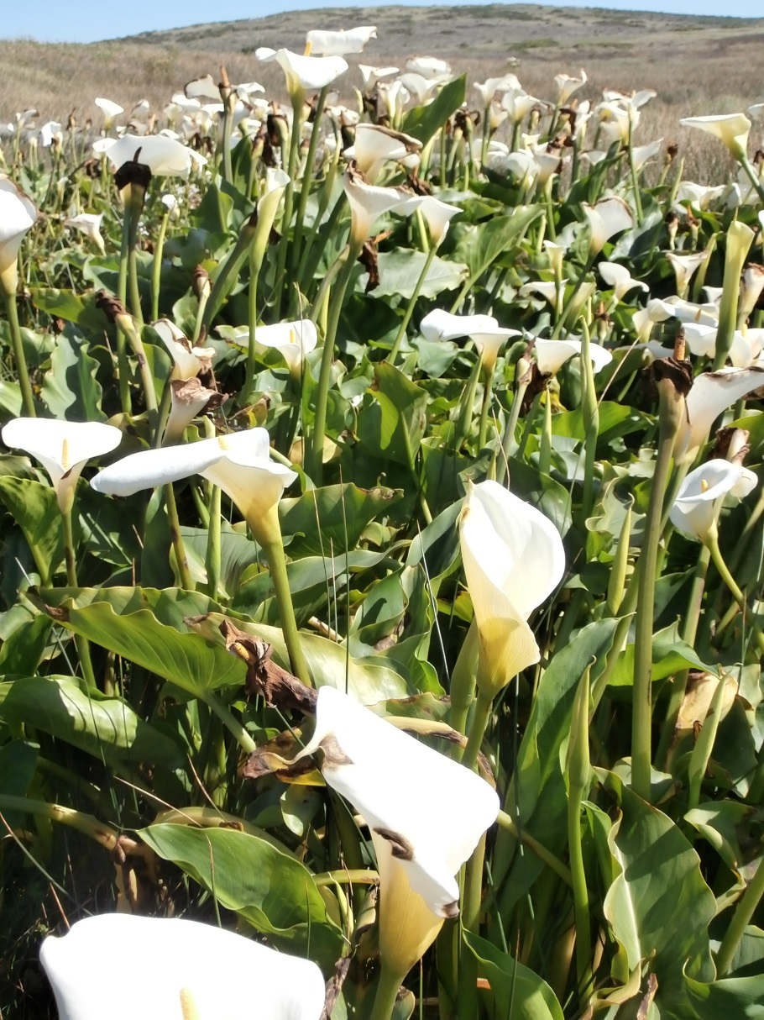
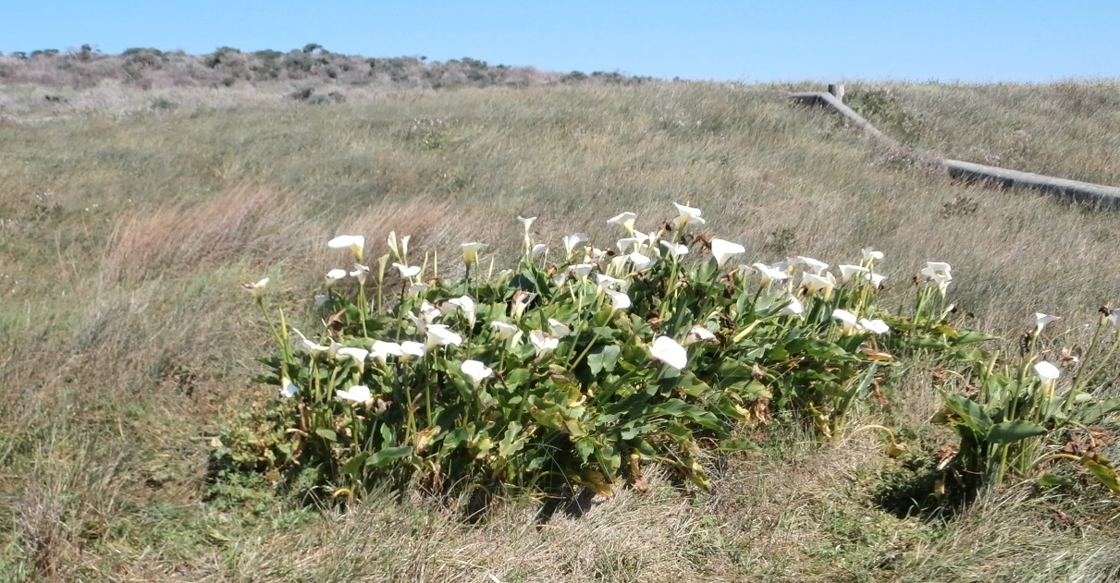
Location of Experiment
Bodega Marine Lab
Calla Lily Patches at Bodega Head

Slide 4
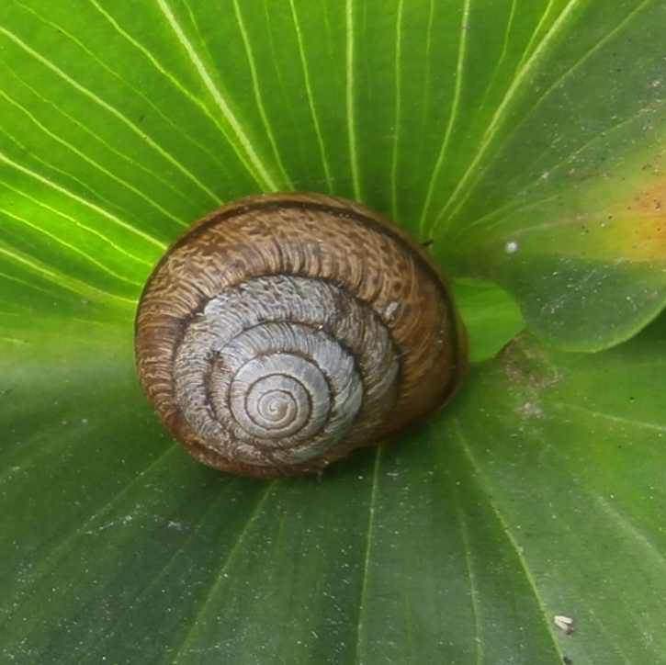
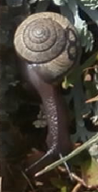
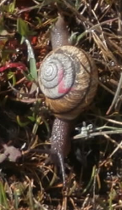
Native Snail
Helminthoglypta arrosa
The bronze shoulderband
Endemic to California
National NatureServe Conservation Status – Imperiled

Slide 5
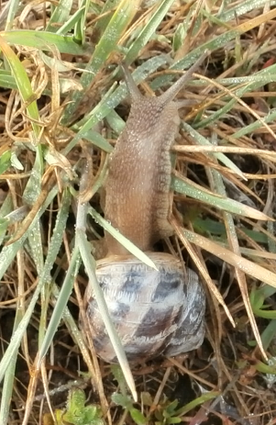
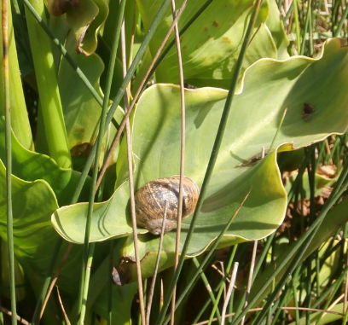
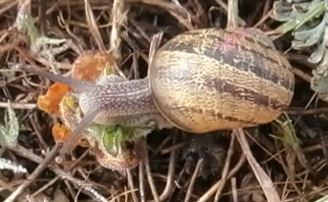
Nonnative Snail
Cornu aspersum (formerly Helix aspersa)
Native to Mediterranean regions in Europe
Cosmopolitan in temperate regions

Slide 6
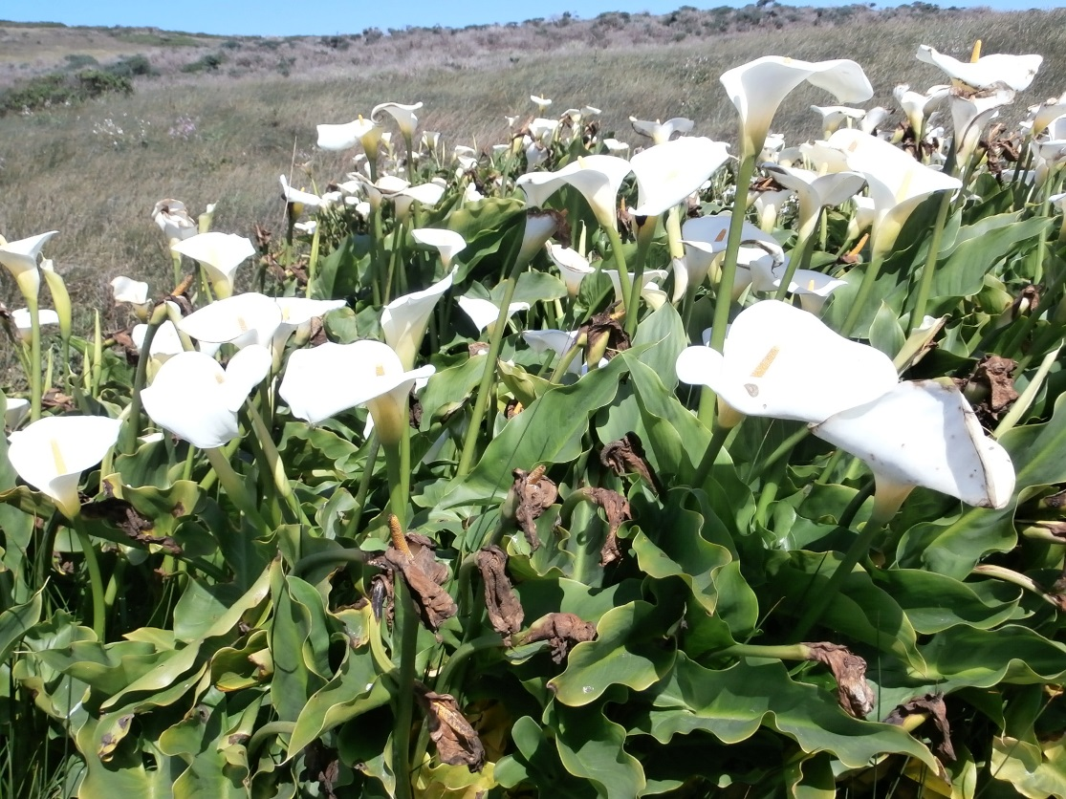

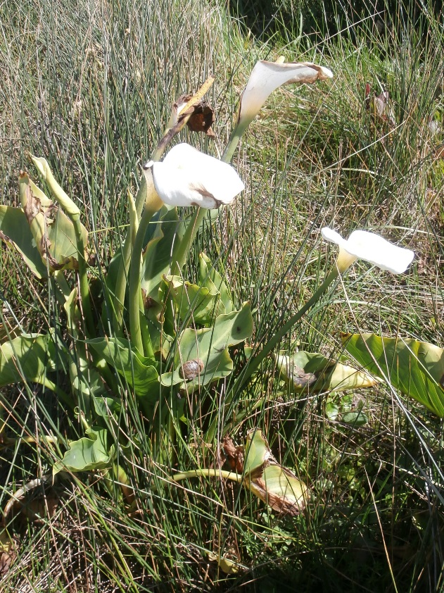
Calla lillies
Zantedeschia aethiopica
Native to Africa
Snails grow on a variety of plants, especially in wet years

Slide 7
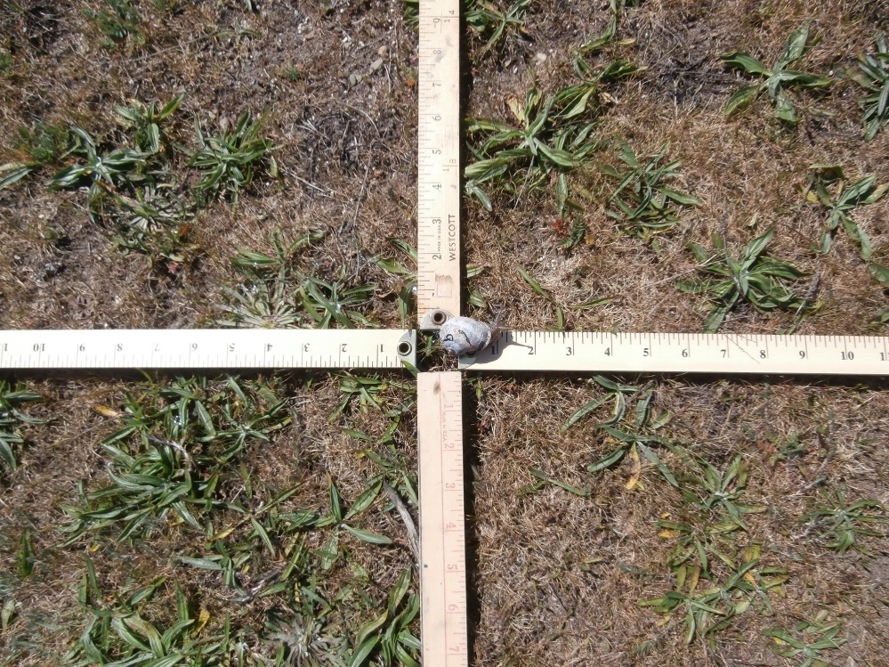
Individual snail movement experiments

Slide 8
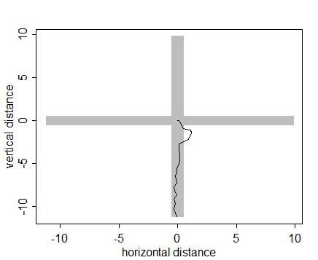
Experimental Setup
Snail position and time tracked for 5 minutes
Position and time recorded every 10 seconds
6 native snails
8 nonnative snails
Dry/warm/afternoon environment
Wet/cool/morning environment

Slide 9
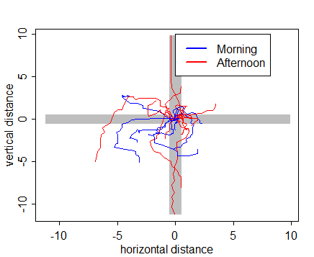
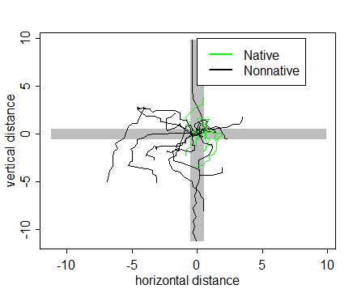
Results
Differences in environment – t-test – not significant
Differences in species – t-test – significant – (t = -3.12, df = 24.38, p = 0.0046)
Varying Environment
Varying Species

Slide 10
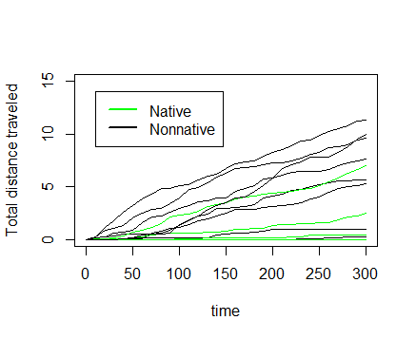
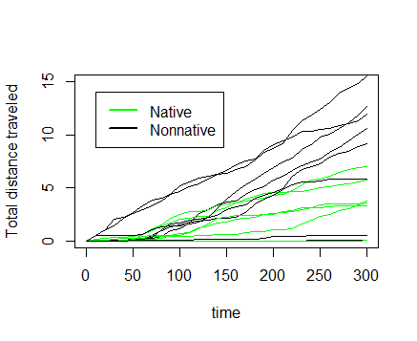
Native snails travel less total distance regardless of environment
Morning Trials
Afternoon Trials

Slide 11
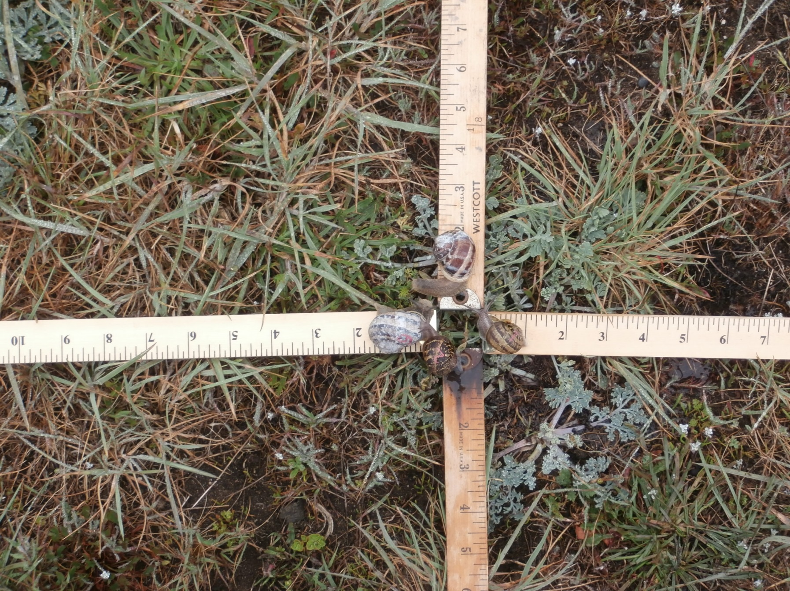
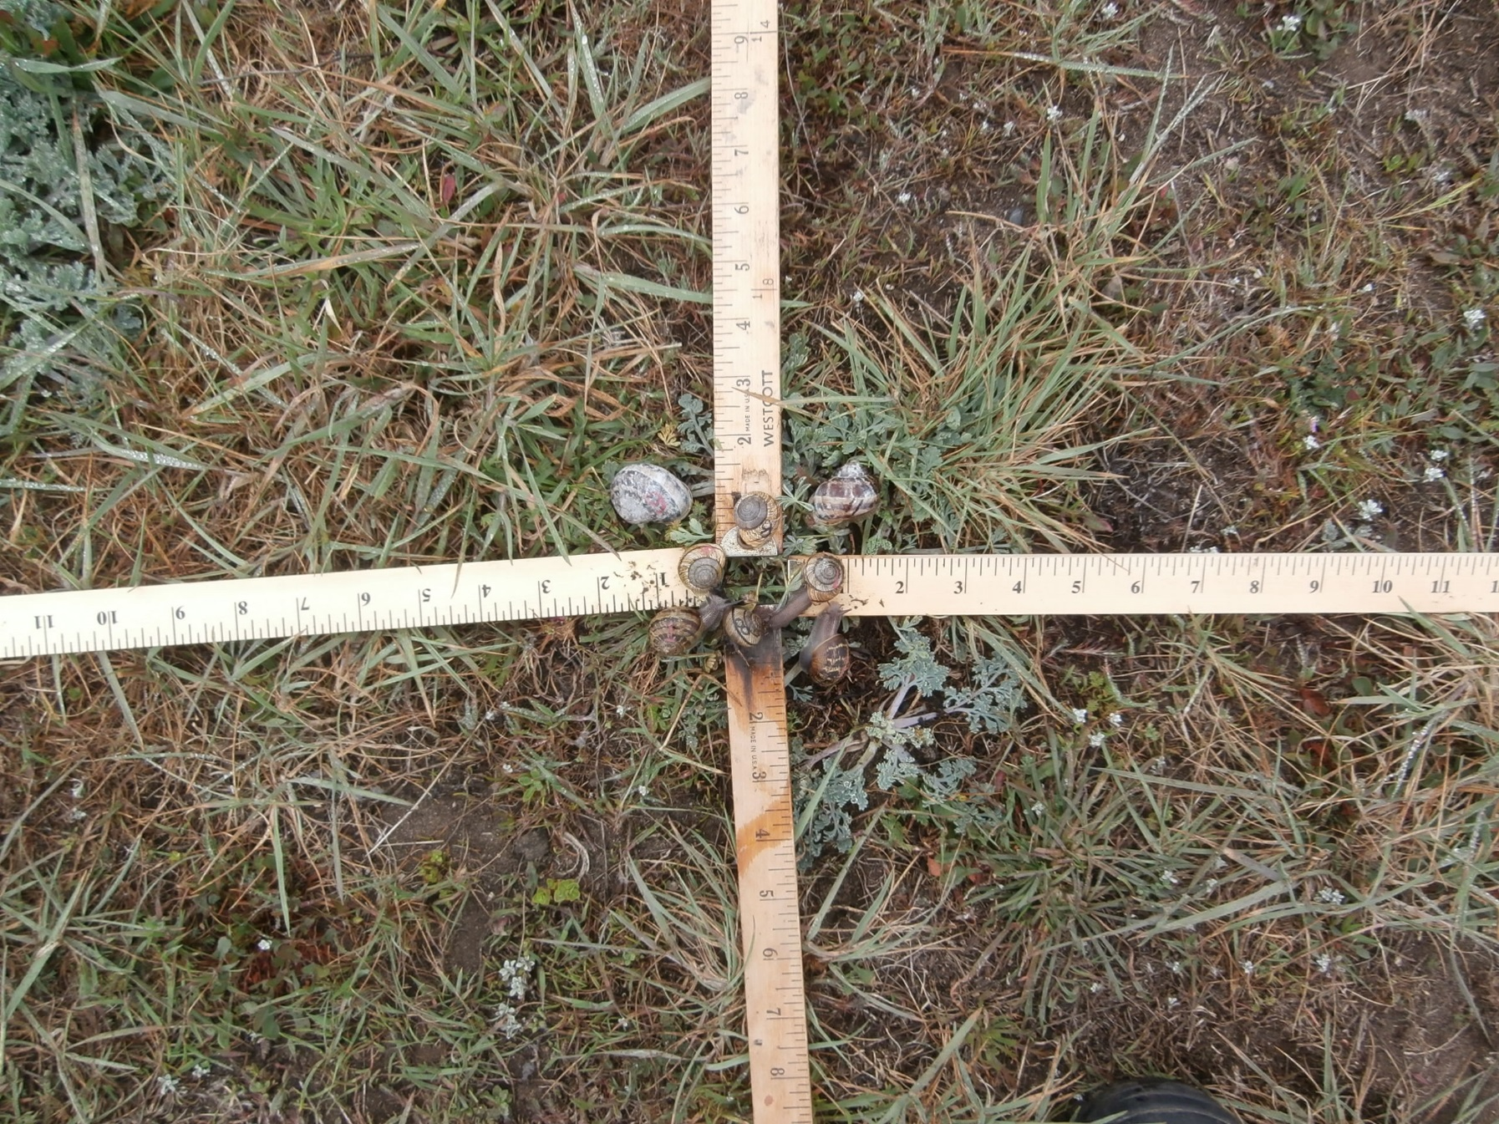
Movement of Snails in Groups

Slide 12

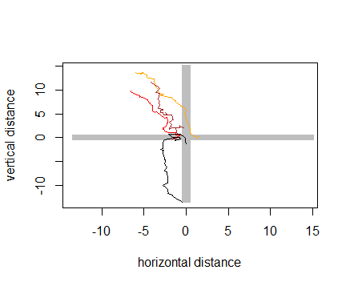

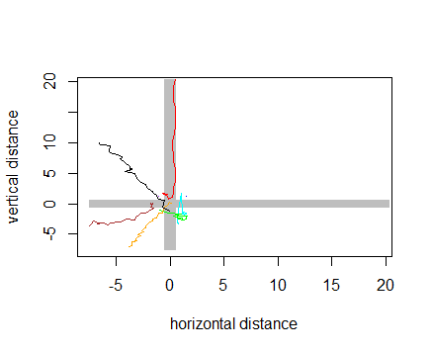
Experimental Setup
All trials in the morning/cool/wet environment
Conspecific group movement:
4 snails of single species placed near origin
Allowed to move for 10 minutes
Position recorded every 10 seconds
2 trials for each species
Heterospecific group movement:
4 snails of each species placed near origin
Allowed to move for 5 minutes
2 trials

Slide 13
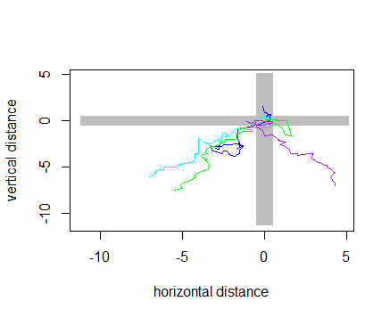
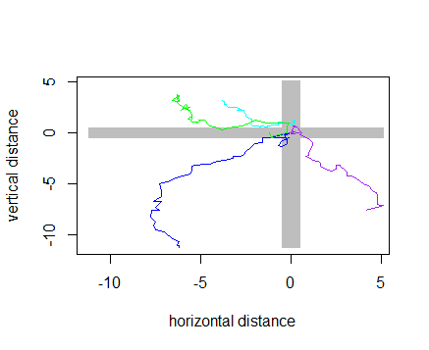
Native

Slide 14
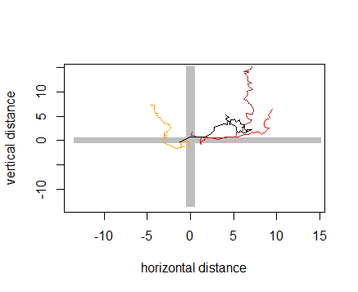
Nonnative

Slide 15
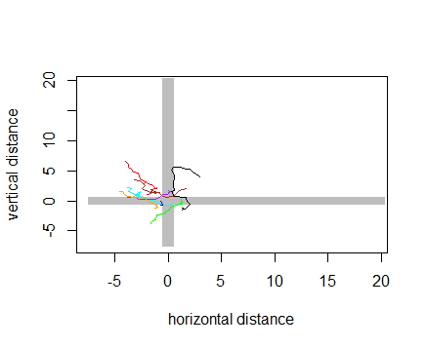
Mixed

Slide 16
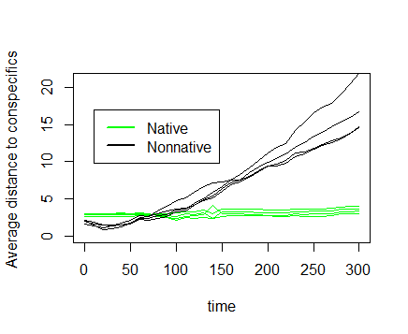
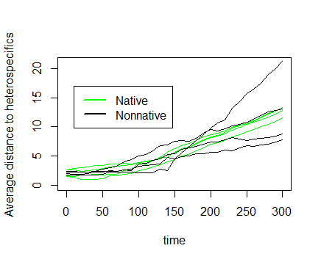
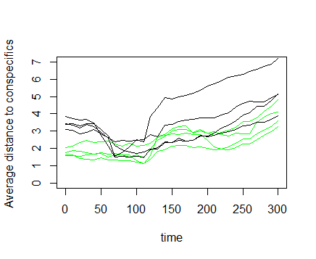
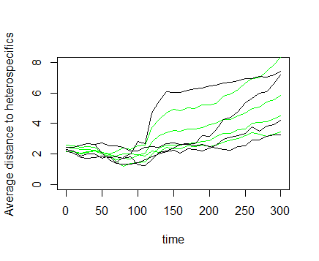
Average distance to neighbors

Slide 17
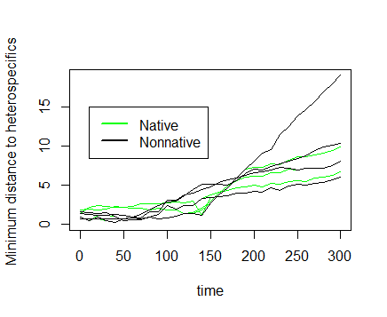
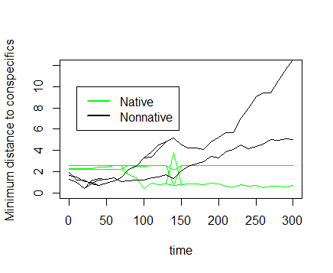
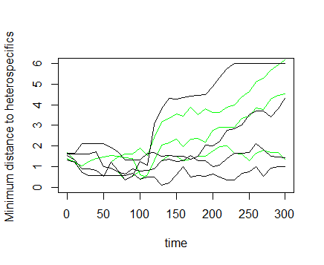
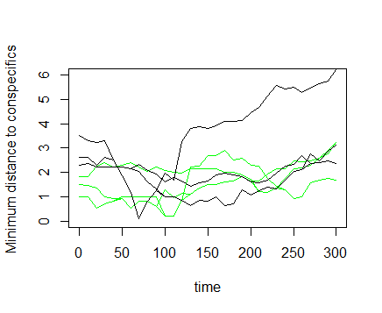
Minimum Distance to neighbors

Slide 18

Simulation of snail population dynamics based on movement patterns
Snails live in patches and can move between patches
Native snails and nonnative snails can coexist
Snails of both species die and are born at the same rate
Native snails move between patches less often than nonnatives

Slide 19
Simulation set-up
Start with 20 patches
Start with 10 snails (on average) of each type in half of the patches
At each step, snails have random chance of giving birth, dying or moving to a random patch
Snails only move to patches with lower population density than their own
This is done until each patch has 100 occupants

Slide 20
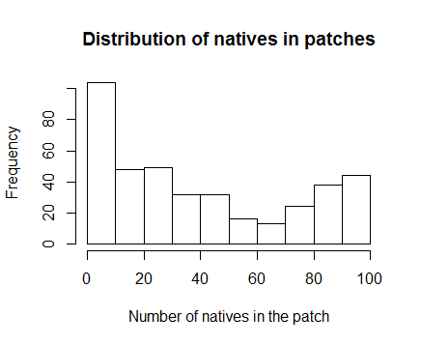
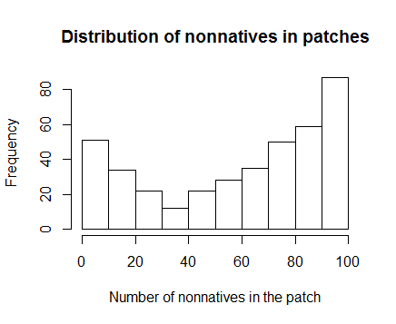
Results
With probability of movement as the only difference between species, the majority of patches have more nonnatives than natives at the end of the simulation
Average number of natives per patch: 40.4 (median 30)
Average number of nonnatives per patch: 59.6 (median 70)
Distributions significantly different by Kolmogorov-Smirnov test, (D=0.31, p < 2.2e-16***)

Slide 21
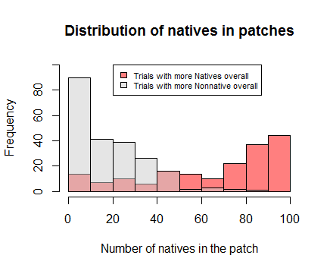
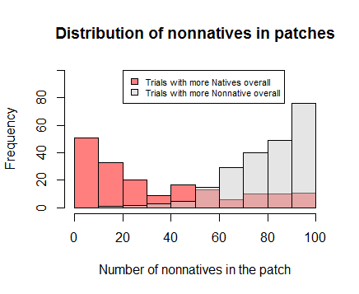

Slide 22
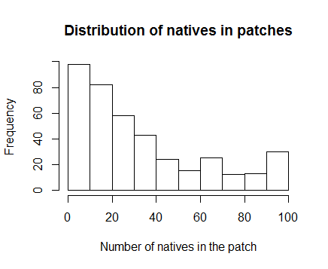
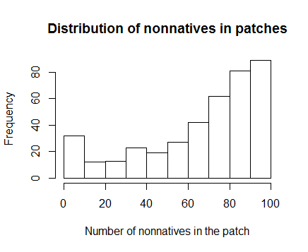
Repeat Simulation, using dry/warm movement rates
 | Cool/wet/morning | Warm/dry/afternoon
Native | 0.84 cm/min | 3.22 cm/min
Nonnative | 1.98 cm/min | 4.21 cm/min
Average number of natives per patch: 33.0 (median 25)
Average number of nonnatives per patch: 67.0 (median 75)
Distributions significantly different by Kolmogorov-Smirnov test, (D=0.52, p < 2.2e-16***)

Slide 24
Comparison of cool/wet and warm/dry environments
Use Bayesian model framework/ MCMC to test the effects of species and environment on population level in a patch

Slide 25
MCMC Results
Model | AIC Weight
Environment, Species and interaction | 1
Species only | 0
Environment and Species | 0
Environment only | 0
Expected population levels (from model)
 | Natives | Nonnatives
Wet/cool environment | 39.5 | 59.5
Dry/warm environment | 33.5 | 66.7

Slide 26


Significance of results
May explain higher abundance of nonnative snails
May explain why some micro-regions/patches have higher abundance of native snails
Might suggest that native snail populations will decline further in response to climate change

Slide 27
Future Directions
Other combinations of parameter values, use more data from experiment
Effect of heritable personality types?
Use model to determine optimal management strategies to preserve native snail populations
Develop analytical partial differential equation model more amenable to analysis

